Slide 1

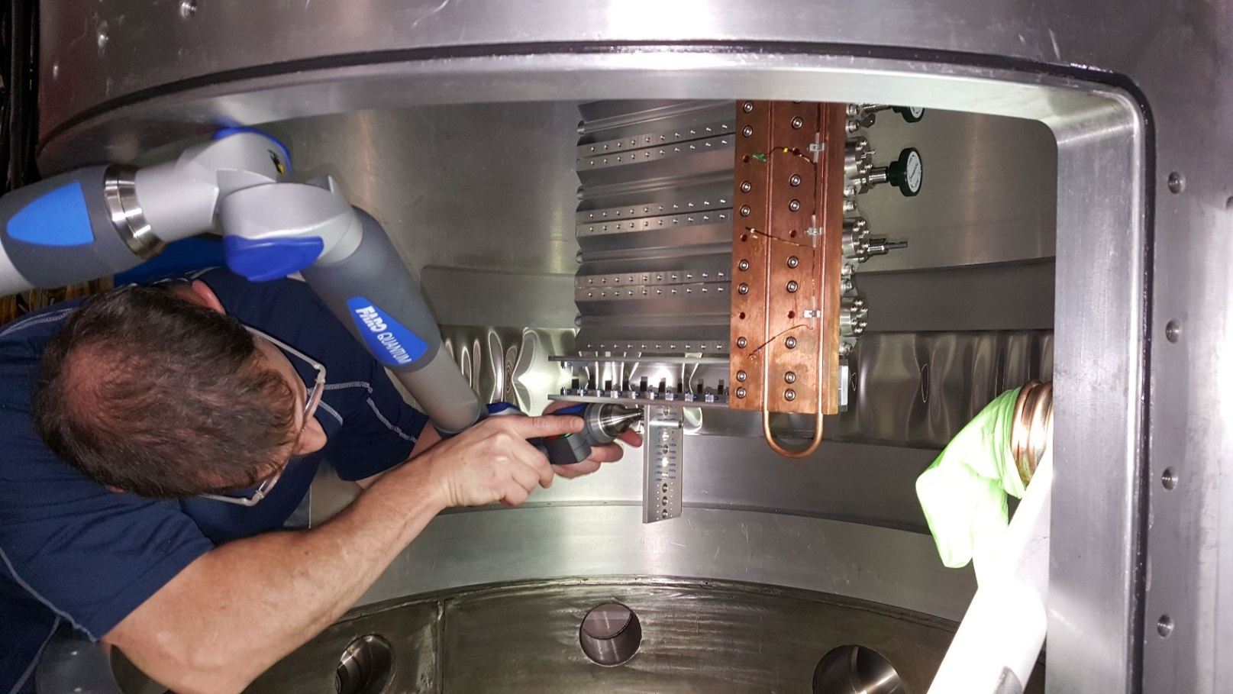

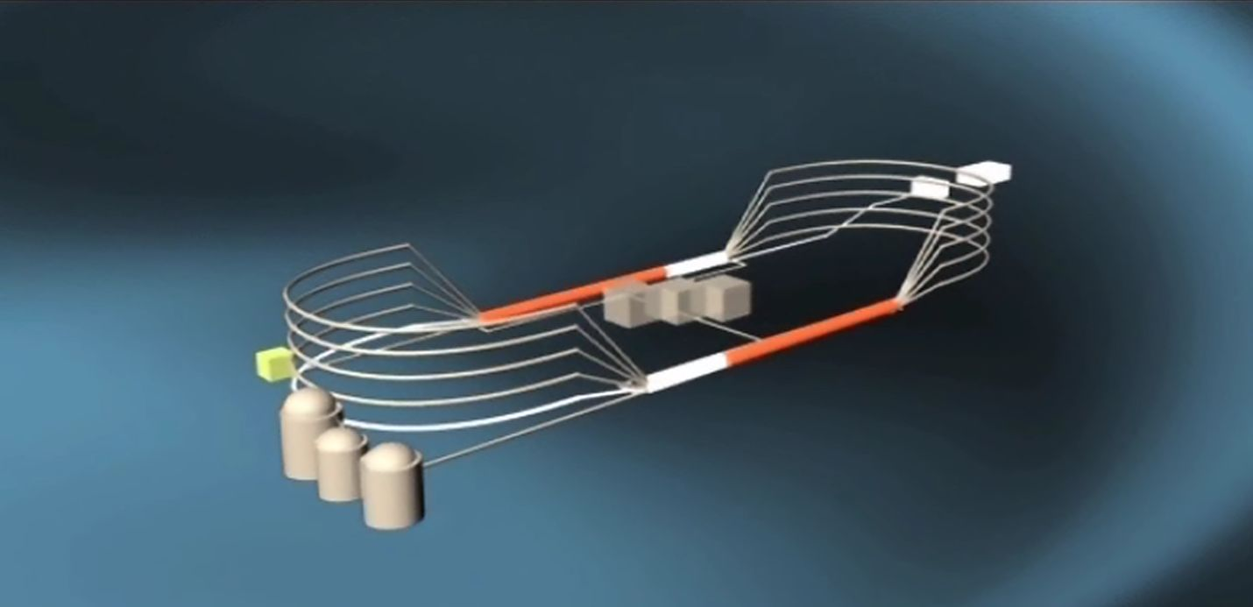
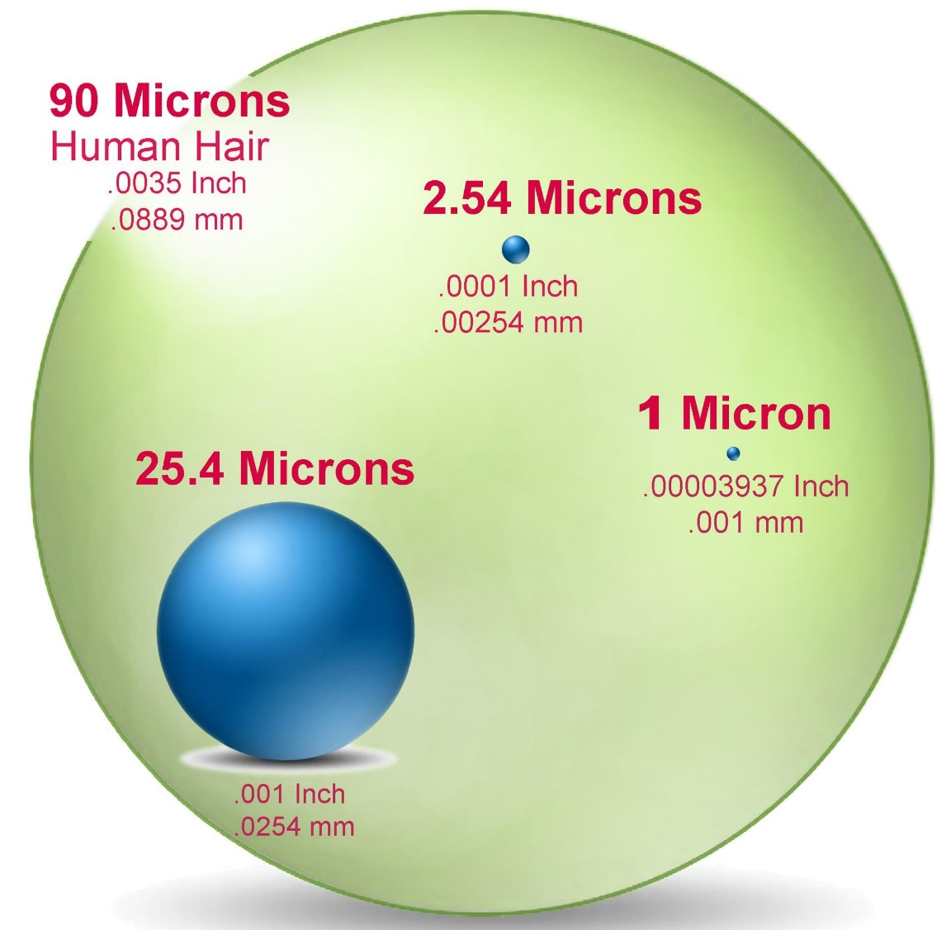
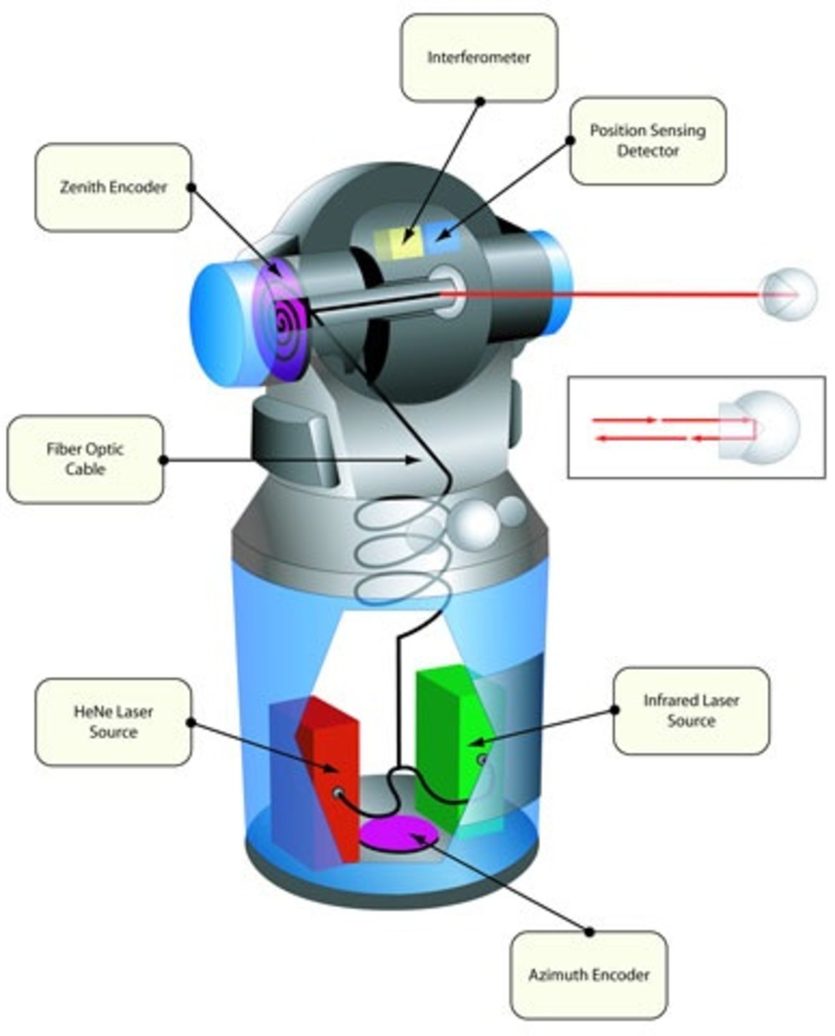
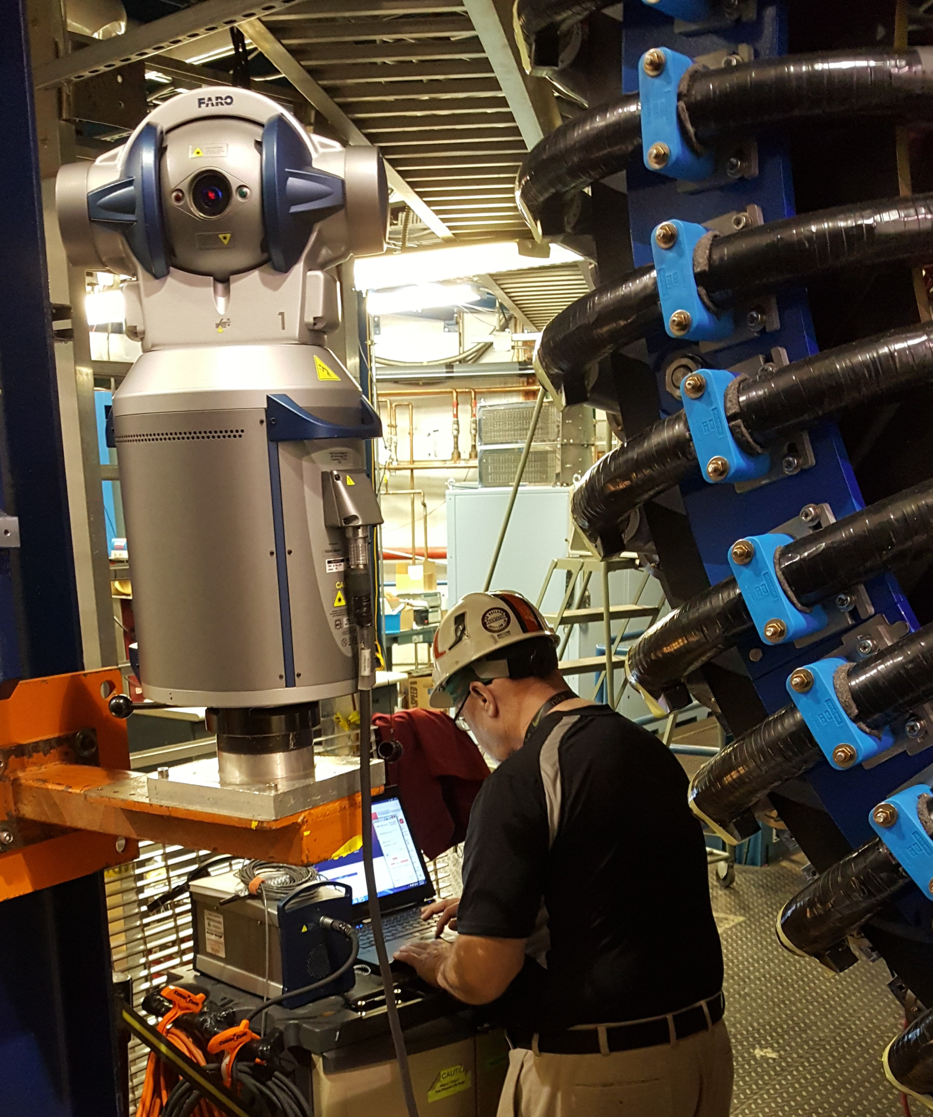
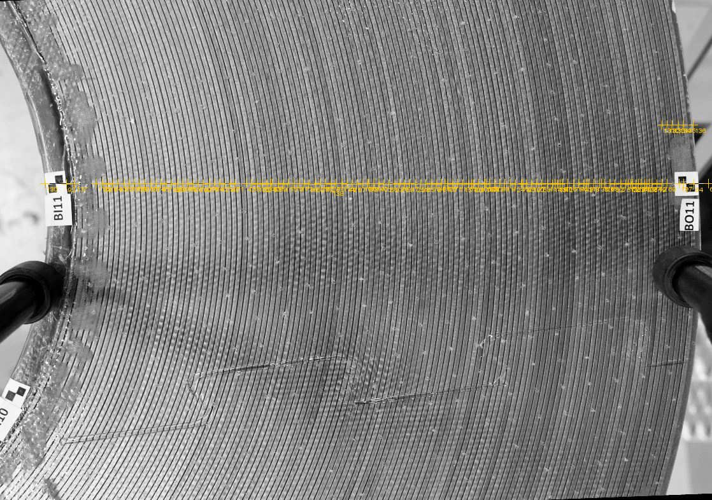
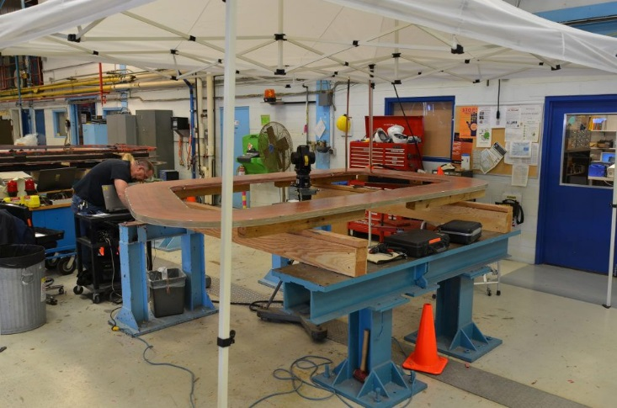
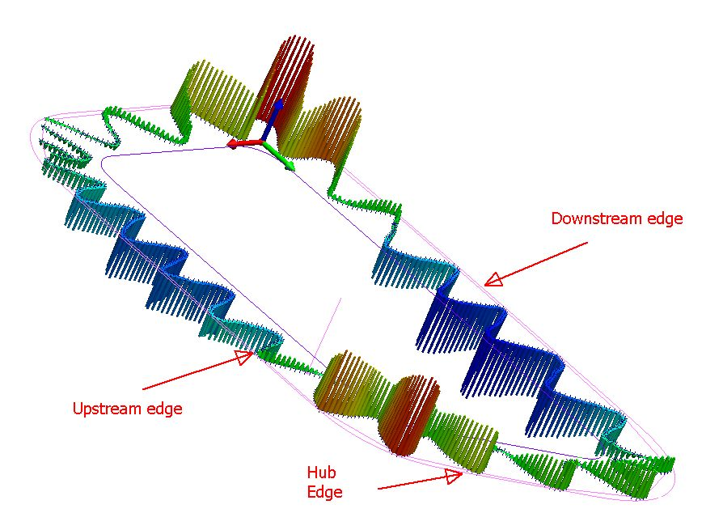
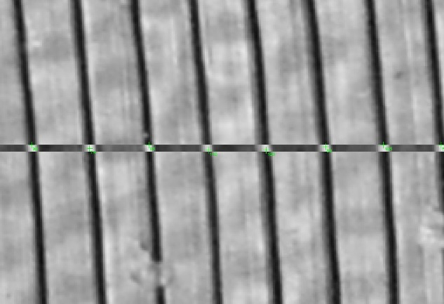
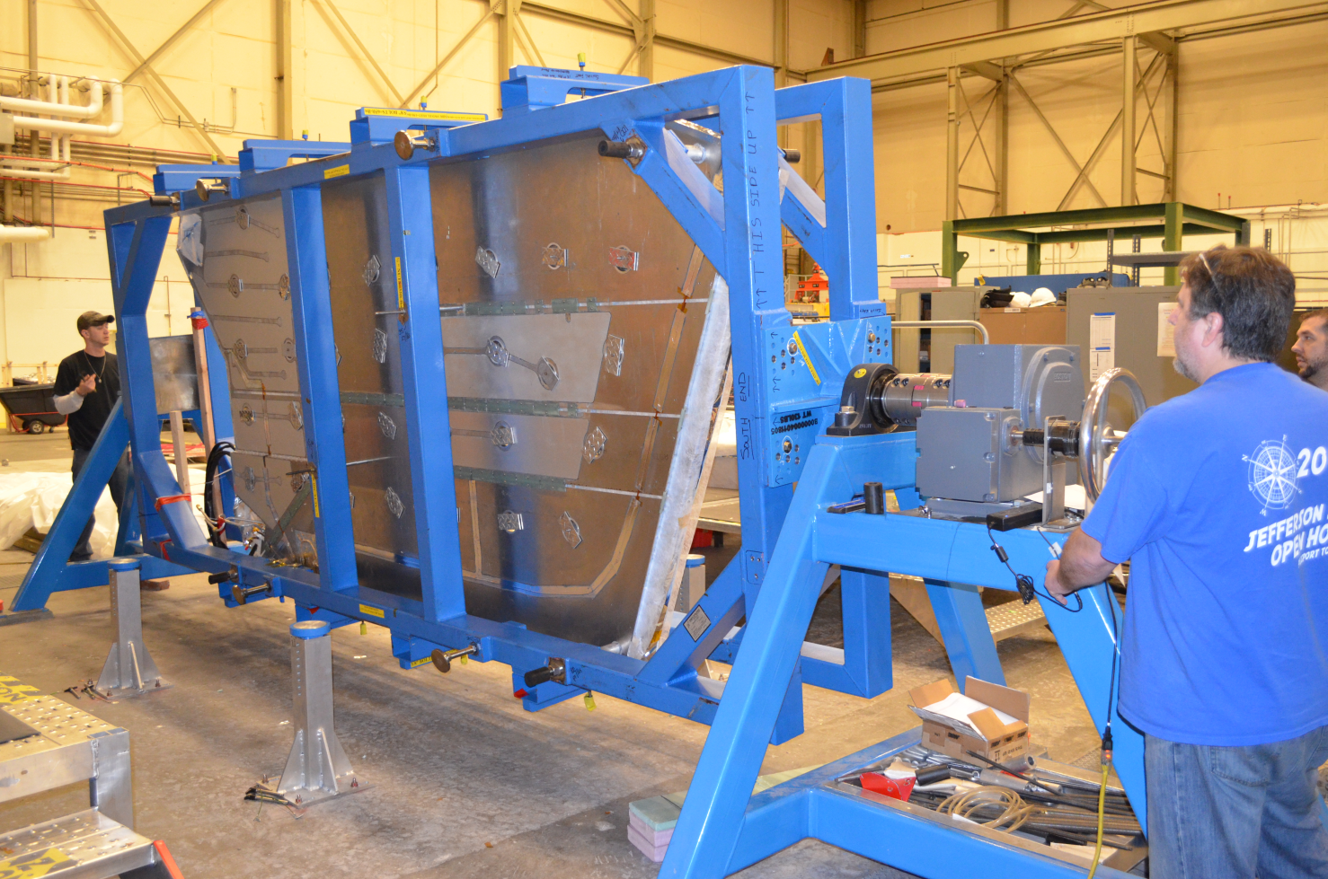
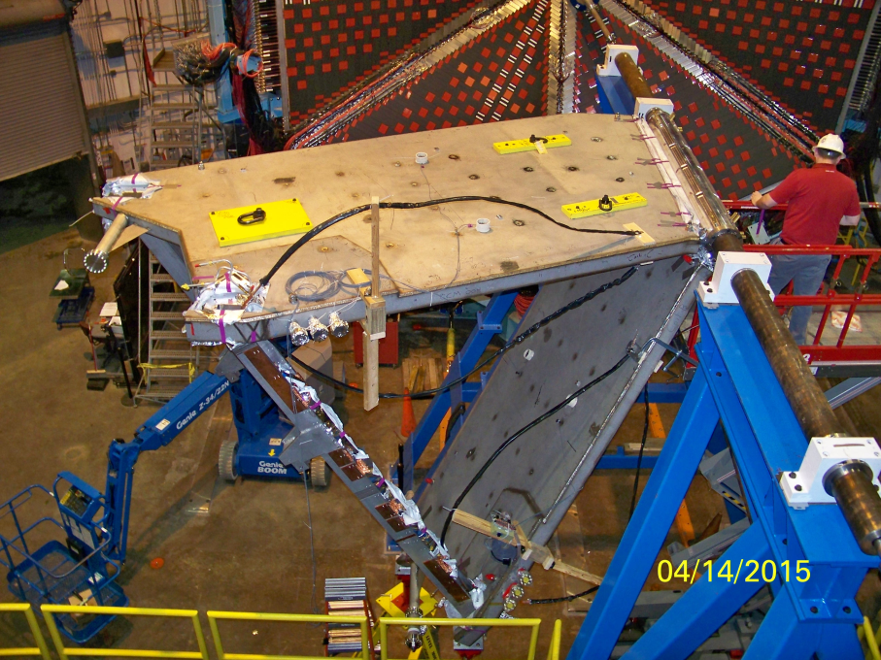
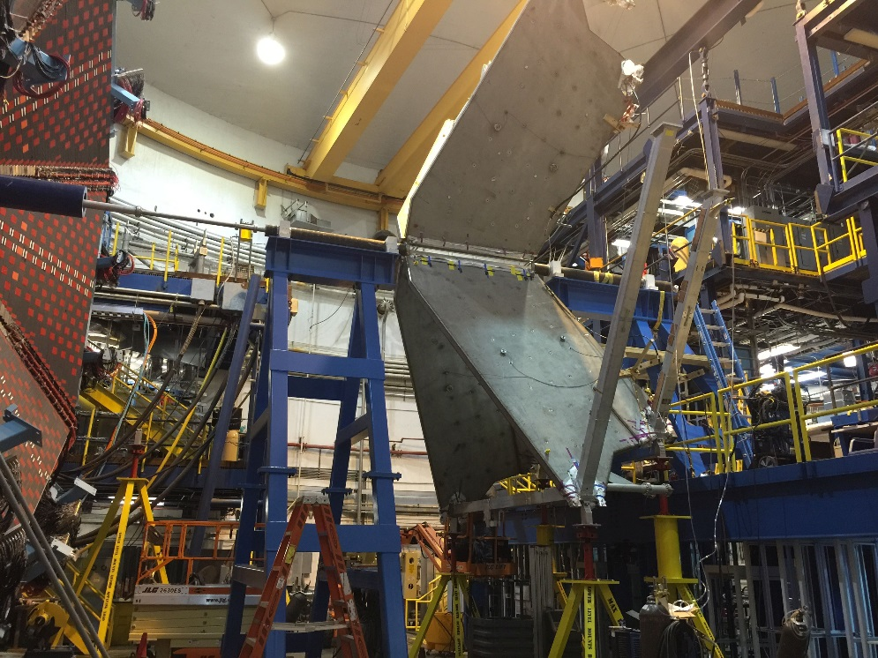
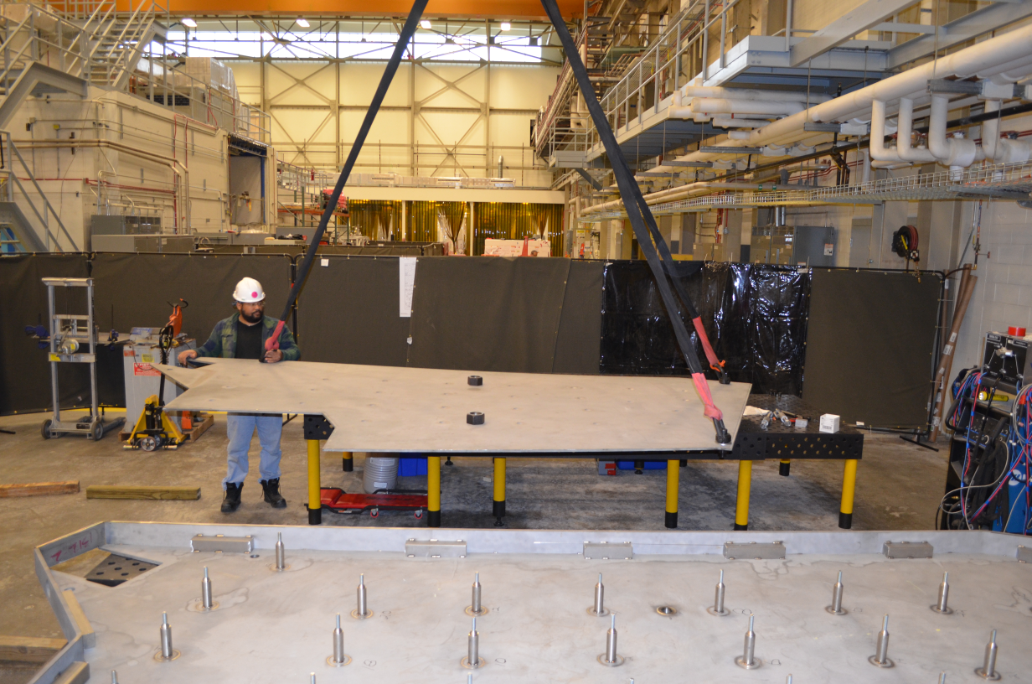
Alignment and Metrology
Thomas Jefferson National Accelerator Facility
Precision, Precision
A Nickel 200 Miles Away
The metrology group at Jefferson Lab provides the the measurement of size and positioning of almost every component that is installed in the accelerator and the experimental halls.
The electron beam is accelerated through the fifty cryomodules of the Linacs and steered through hundreds of magnets through the Arcs five times. That is a distance of almost 7 kilometers (4.4 miles) from the injector to the target.
How does the metrology group measure the relative positions between all these hundreds of components so far apart from each other?
How can they ensure that the beam ends up dead center on the various targets in the 4 JLab experimental hall?
North Linac
A human hair is on average about 90 microns wide, or 0.0035 of an inch.
The metrology group is able to measure the size of individual components to approximately 50 to 80 microns.
Physicists typically require for components to be positioned within a tolerance of 250 microns (3 human hairs), an easy task for the JLab metrology group even when they measure the hundreds of components of gigantic, heavy machinery.
West Arc
East Arc
Injector
Hall B
South Linac
The metrology group has built throughout the accelerator a network of control points to the highest level of accuracy. The individual accelerator components sizes and positions are computed relative to the control points and the correlated to each other.
The overall accuracy of the entire system is less than 0.5 millimeters from the start of the injector to the targets of every experimental halls. To put this in perspective, this is like hitting a nickel more than 200 miles away.
JLab metrology group precision: 50 microns, or about half a human hair
Laser Trackers
Fiducialization
Laser trackers are one of the instruments used in the alignment and measurements of the accelerator’s components and experimental detectors.
The trackers use a spherical coordinate system, which means that any given point is specified by three numbers:
1. The radial distance of the point from the tracker
2. The polar or zenith angle, which measures elevation
3. The azimuth angle
The numbers for the zenith and azimuth angles are determined by two angular encoders which measure the orientation in the tracker’s gimbal along its mechanical axes. The radial distance of the point from the tracker is determined using an interferometer (IFM), an absolute distance meter (ADM) or a combination of the two.
In interferometer mode, the distance measurement from the laser tracker is accurate to about 0.005 millimeters at 10 meters from the laser’s head.
Interferometer
Position Sensing Detector
All components are pre-measured in a process called fiducialization: a “local” set of coordinates are established for each individual element in component.
The coordinates are then ported to the desired installation coordinate using a portable measuring machine or a laser tracker. This is how the components are installed in their final desired location with incredible accuracy.
The fiducialization process can take days or weeks for some components. Other components are manufactured very precisely, and after some quality checks, can be installed using design values.
Some components are very complicated, like SVT and the Hall-B Torus magnet, and in this case it can take many months to measure and get their final local coordinates.
The most precise work that the metrology crew had to align to was in the Free Electron Laser where the wiggler magnet needed to be measured to 10 microns. That’s one tenth the size of a human hair!
Zenith
Encoder
Fiber Optic Cable
HeNe Laser Source
Infrared Laser Source
Azimuth
Encoder
Sr. Metrology technician Steven Hardisty aligning the SVT/Hall B target
How the Hall-B Torus Magnet was built with sub-millimiter tolerances
Blow up of points measured
The Hall-B Torus magnet consists of thousands of individual parts. Knowing the positions of the individual components is crucial to calculate the magnetic field in its final position: that is how we measure the particles momentum.
Left: each magnet coil has 117 winding. Right: a full completed coil being fiducialized by the metrology group.
After fiducializing the individual coils, a map of their surface and edges were calculated. The magnets engineers used this data to extrapolate the field strength and produce 3D distributions used by physicists in their reconstruction algorithm.
Central Hub
Coils inside the vacuum jackets
4 of the 6 coils installed – waiting for #5
Next, the coils were shipped to JLab and installed in to the coil containment case and vacuum jacket. Each of these steps required further surveys to tie one step to the other.
Around the beamline a central hub (left) was installed. This was a very tightly manufactured component and it was fiducialized and aligned to the overall beamline location. The next step was to fit each of the six vacuum jackets containing the coils to each other, then eventually to the beamline.
It took over two years to complete all the surveys until the Torus magnet was finally constructed. As you see it now, the magnet is aligned relative to the beam to 0.5 mm transverse and 0.1 mm precision

